Slide 1

Three-Tier Architecture
Notes:
Quick intro about my self.
BTech from IIT Roorkee – oldest Asian technical institute.

Slide 2
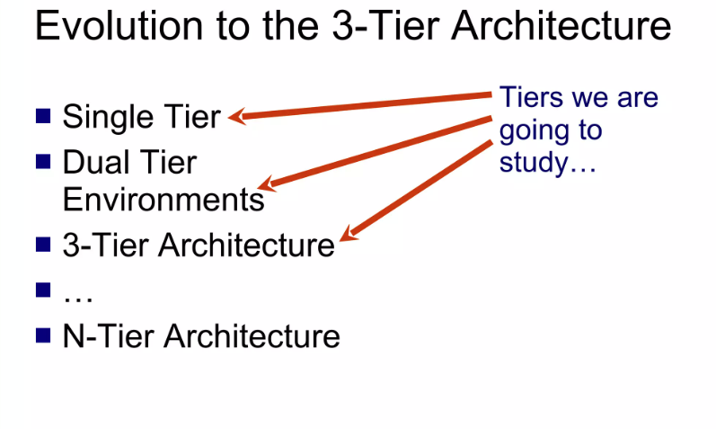

Slide 3
Why do we use 3 tier application
We use a three-tier structure to control large projects. For instance, let us say you wrote 2000 entity codes and coded all the code in a single layer. Say you want to interchange between home windows software and cellular or web applications, and you must rewrite the code for all 2000 entities.

Slide 4
Why do we use 3 tier application
we use 3-tier architecture because of these points
Accelerated development
Improved scalability
Improved Reliability
Enhanced Security

Slide 5
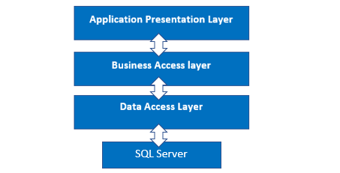
3-tier architecture structure

Slide 6
Presentation Layer (PL)
The Presentation layer is the top-most layer of the 3-tier architecture, and its major role is to display the results to the user, or to put it another way, to present the data that we acquire from the business access layer and offer the results to the front-end user.

Slide 7
Business Access Layer (BAL)
The logic layer interacts with the data access layer and the presentation layer to process the activities that lead to logical decisions and assessments. This layer's primary job is to process data between other layers.

Slide 8
Data Access Layer (DAL)
The main function of this layer is to access and store the data from the database and the process of the data to business access layer data goes to the presentation layer against user request.

Slide 9
Implementing 3-Tier Architecture in web Api

Slide 10
Advantages of 3-Tier Architecture
In This Model, Each tier is independent so we can set the different developers on each tier for the fast development of applications
Database security can be provided at BAL Layer
Easy to Appy for Object-oriented Concepts
Migration to the new environment is fast.

Slide 11
Dis-Advantages of 3-Tier Architecture
It takes a lot of time to build the small part of the application
Need Good understanding of Object-Oriented programming

Slide 12
Any Questions ?

Slide 13
Thank You

